Slide 1

Learning Outcomes Assessment at Penn State
Review and Update
Office of Planning and Assessment
February 28, 2018
12 – 1 pm
*This session is being recorded
Office of Planning and Assessment

Slide 2
This webinar will answer the following questions (and more)
Who uses information gathered through learning outcomes assessment?
What is the learning outcomes assessment process?
Which learning objectives are other programs assessing and how?
What are some examples of good assessment reports?
What’s next for learning outcomes assessment at Penn State?
Office of Planning and Assessment

Slide 3
Who uses learning outcomes assessment information?
Office of Planning and Assessment

Slide 4



Who uses learning outcomes assessment Information?
Kinesiology
Biology
Psychology
Office of Planning and Assessment
Notes:
The primary audience for assessment work is the program faculty and students.
The assessment process is developed by faculty for faculty and students. The process can either confirm that students meet program learning objectives (yea!) or discover opportunities to make changes that improve student learning. Assessment information might also be used as evidence for needed resources.
Because program faculty are the primary recipient of assessment results, it’s important that the process be approached with the goal of collecting evidence that will provide meaningful information.

Slide 5


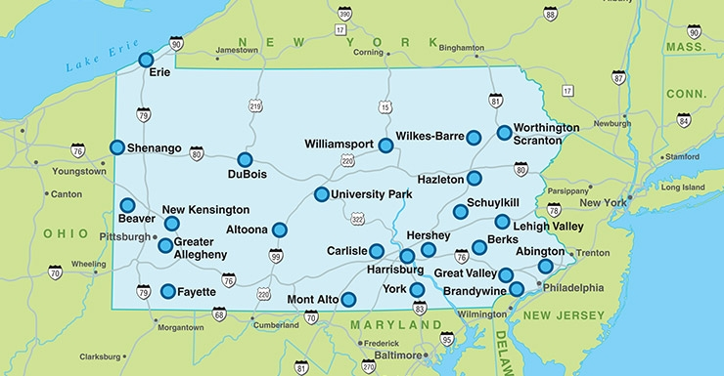
Office of Planning and Assessment
2023/2024
Colleges/Campuses
Office of Planning and Assessment
Notes:
Office of Planning and Assessment (OPA) – The primary goal of OPA is to provide feedback to program faculty designed to strengthen the assessment. The information requested in plans and reports informs our ability to coach program coordinators and directors of graduate studies. OPA also uses the reports to provide evidence of the level of engagement in the process and share aggregate information about objectives being assessed and methods of assessment.
College/Campus
A college/campus unit might use assessment evidence to analyze trends and inform decision-making about where to focus efforts and/or resources.
Middle States Commission on Higher Education
Our next accreditation visit from Middle States is 2023/2024. Evaluators will want to see that Penn State has a systematic process to assess learning in all programs – undergraduate, graduate, certificate, and General Education. They will be interested in the extent to which learning outcomes assessment data has resulted in changes that have improved programs or re-affirmation that students are meeting learning objectives. In addition, they will want to know if learning outcomes assessment evidence is being used to drive decision-making at Penn State. They will be interested in examples, but will not be review individual plans or reports.

Slide 6
What is the learning outcomes assessment process?
Office of Planning and Assessment
Notes:
We are currently using Penn State Box for the assessment process. If you are a program coordinator or director of graduate studies you should have access to that folder. It contains resources – guidelines, rubrics, etc., - and report templates and examples. If you do not have access, please let us know.

Slide 7

Penn State
Learning Outcomes Assessment Process
PROGRAM LEARNING OBJECTIVE
+
LEARNING QUESTIONS/CONCERNS
ESTABLISH/REVISE PROGRAM LEARNING OBJECTIVES AND DEVELOP CURRICULUM MAP
2
CHOOSE/DESIGN ASSESSMENT METHODS
1
3
DETERMINE IMPROVEMENT IMPACT
8
COLLECT ASSESSMENT
DATA/EVIDENCE
4
7
5
IMPLEMENT CHANGES
REVIEW ASSESSMENTS/
DETERMINE ACTION
6
SUBMIT REPORT
Notes:
The assessment process begins with the end - establishing clear and measurable learning objectives that describe the knowledge and skills that you expect of your students at the time of graduation. The phrasing of these is very important – these statements should be written so that it is easy to tell how you will know if students have met them. Additional information about how to write these statements is in your box folder. Once the program objectives are written, the faculty create a curriculum map, which indicates the courses or experiences that align with each objective and at which level (introductory, practice, mastery).
The program learning objectives and curriculum map form the foundation for an assessment plan. They only need to be done once, though it is possible they may be adjusted over time based on assessment results. To develop a plan, choose a learning objective to assess and hold a discussion with faculty about any learning concerns or questions around that particular objective. For example, for a knowledge objective, faculty may have noticed that students are not entering 400 level courses with the knowledge needed to succeed in the course? Or maybe there are no specific concerns but faculty want to know if students are able to think critically when they graduate.
Once you know the learning objective and learning issue, you will be able to develop a plan – choose an appropriate measure and method of assessment. If you are interested in determining whether or not students have the necessary knowledge to succeed in a 400 level course, you will want to administer a pre-test at the beginning of the course or courses. If you are interested in critical thinking, a capstone project may be the best assessment measure.
Now you are ready to collect evidence in the most appropriate semester, or even multiple semesters.
Faculty review assessment results together and, if necessary, determine why students did not meet the objective – the program structure, the way the assignment or rubric was written, the student characteristics, or the study design? A determination of the reason for low performance leads to actions that changes that could be implemented to improve student learning in the program.
Next, you submit your report to us – providing the information we need to give useful feedback.
During the following semesters, you may implement changes
Ideally, if you implement changes, you should re-assess to determine whether or not the changes made a difference.

Slide 8
Penn State Learning Outcomes Assessment Process
PROGRAM LEARNING OBJECTIVE
+
LEARNING QUESTIONS/CONCERNS
ESTABLISH/REVISE PROGRAM LEARNING OBJECTIVES AND DEVELOP CURRICULUM MAP
2
CHOOSE/DESIGN ASSESSMENT METHODS
1
3
DETERMINE IMPROVEMENT IMPACT
8
COLLECT ASSESSMENT
DATA/EVIDENCE
4
7
5
IMPLEMENT CHANGES
REVIEW ASSESSMENTS/
DETERMINE ACTION
6
SUBMIT REPORT
June 30th
Notes:
Steps 1, 2 and 3 make up the assessment plan. If you have not done one before you will complete the 2nd part of the report template and submit it on June 30th.
Steps 4 and 5 make up the assessment report, which is the first part of the report
Steps 6 and 7, if needed, would be reported on the following year.
This year we have added a place to indicate why you did not collect data this year and explain why (e.g. no graduates, a small number of students). Even if you have nothing to report, please submit a report and explain why.

Slide 9
Revised Report Template
TABLE 1: 2017-18 REPORT ON ASSESSMENT OF YOUR PROGRAM LEARNING OBJECTIVE(S)
Program learning objective you (PLO) assessed this year. Categorize your PLO. | Click to enter the PLO you assessed (copy and paste from your plan). | Click to select a PLO category.
Describe the assessment measure used to assess your PLO. Categorize your measure. | Click to describe the measure used to assess your PLO (copy and paste from your plan). | Click to select an appropriate category for your measure.
Did you utilize a rubric with your measure? | ☐ Yes ☐ No
Performance criterion or benchmark for your measure. | Click to copy and paste the measure’s performance criterion/benchmark from your plan.
Summary of findings. | Click to briefly describe the findings of your assessment study.
Performance criterion, benchmark, or expectations met? | Click to categorize your students’ performance. | Click to briefly describe your students’ performance (optional).
***COMPLETE #9-#12 ONLY IF YOUR 17/18 STUDY RE-ASSESSED A PLO AFTER CHANGES MADE ***
Change(s) you made in response to previous assessment study findings. Categorize the change(s) you made. | Click to briefly describe changes your program made. |  | Click to categorize the type of change you made.
What was the impact of the change(s)? Categorize the nature of the impact. | Click to briefly describe the impact of the changes your program made. |  | Click to choose the nature of the impact.
Supporting assessment documents not already submitted with plan (Please submit separately). | ☐ Rubric(s) | ☐ Internship/Employer evaluation
 | ☐ Assignment prompt(s) | ☐ Additional findings/discussion
 | ☐ Exam question(s) | ☐ Other (click here to enter other)
 | ☐ Survey instrument(s)
Notes:
This slide shows a portion of the revised report template. We have modified the report template by requesting additional information about how you would categorize the learning objective you are assessing and the measure used to assess it. We have also added questions related to changes you might have made and the impact of those changes on student learning. The first part of the report documents the evidence found during the past academic year. The second part of the report is an assessment plan for the following academic year.

Slide 10
What are others assessing and how?
Office of Planning and Assessment

Slide 11
Report Submissions
Rates of Assessment Report Submissions
Program Type | Number of programs | % 16-17 Report Submissions
Baccalaureate | 267 | 71% - 81%
Associate | 53 | 36% - 64%
Graduate Programs | 249 | 74%
Office of Planning and Assessment
Notes:
These number represent programs that are not accredited by disciplinary organizations.

Slide 12
Most commonly assessed PLOs in undergrad programs:
Knowledge, critical thinking, application, and communication
Cultural competence; Ethics; Team work; professional practice; research
15%
Cultural competence;
Ethics;
Team work;
professional practice
research
24%
Cultural competence; Ethics;
Team work;
professional practice research
44%
Communicate 10%
Communicate 22%
Apply 31%
Communicate 15%
University Park
85%
N = 61
Apply 17%
Campus Colleges
76%
N = 75
Think critically 16%
University College
56%
N = 89
Apply 14%
Think critically 20%O-2
Know 28%
Think critically 16%
Know 17%
Know 10%
Office of Planning and Assessment
Notes:
Some programs assessed more than one objective. The numbers/ percentages reflect the number of objectives, not the number of programs.

Slide 13
Most commonly assessed PLOS in graduate programs:
Knowledge, Application/Creation, and Communication
Professional Practice 8%
Think critically 14%
Communicate 17%
Graduate Programs
Apply/Create 21%
Know 41%
UP
Harrisburg
Great Valley
Office of Planning and Assessment
Notes:
Grad programs are required to align their objectives with the Grad Council objectives.

Slide 14
Most common types of assessment measures employed
In-course assignments
64%
Surveys
17%
Course grades
24%
Culminating Exams
36%
Undergraduate assessment measures
Graduate assessment measures
Office of Planning and Assessment
Notes:
Undergraduate programs commonly rely on in-course assignments for assessment. These should be major assignments that are aligned with the program objective and as authentic as possible (similar to what student would face in the real world). In-course assignments include exams, papers, projects. Examples include journal article summaries to assess communication of research in 400-level biology course or 3 essay questions scored by multiple faculty to assess knowledge in sociology.
Grad programs often use culminating exams like thesis papers and/or defense examinations for assessment. They also often used course grades, which we don’t recommend because they are a mixture of multiple objectives, some of which might not align with a particular program objective. Also, the grading process differs depending on the particular faculty member. Other Graduate measures included training, surveys, milestone knowledge exams, research publication, post-graduate placement

Slide 15
Rate of rubric usage (when appropriate) in Undergraduate and Graduate assessments
72%
60%
Office of Planning and Assessment
Notes:
Rubrics are excellent assessment tools. More about that later.

Slide 16
What are some examples of good assessments?
Office of Planning and Assessment

Slide 17
Political Science/International Politics (UP, HB, AL, WC)
Students will be able to define and use the concepts political scientists employ to make and substantiate knowledge claims
Faculty-designed quiz
Expectations met; Students taking Poly Sci 14 performed better than those who didn’t
Changes to degree requirements
Research Design!
Notes:
Poly Sci faculty developed an online quiz collaboratively and administered it outside of class to students at varying levels of the curriculum to explore development through the curriculum. Student met the criteria. However, students who took Poly Sci 014 scored better than those who didn’t. This research design helped the program did deeper and change the degree requirements so all students could meet the objective.

Slide 18
Biochemistry and Molecular Biology (Penn State Berks)
Students will be able to read, understand, and critically interpret primary scientific literature.
Final Exam based on scientific article; scored with a rubric
Criteria not met for 3 of the 4 assignment elements
Identify courses in the curriculum where students can get more practice
Great use of rubric!
Notes:
In BMB, a final exam required students to read a primary research article and answer questions about it. Students met the criteria for analysis and interpretations of data, but not for general scientific content, experimental design, or proposing mechanisms. Use of a rubric allowed the faculty to look deeper than overall scores.

Slide 19
AAC&U VALUE Rubric
Focus Area | Capstone 4 | Milestones 3 and 2 |  | Benchmark 1
Define Problem | Demonstrates the ability to construct a clear and insightful problem statement with evidence of all relevant contextual factors. | Demonstrates the ability to construct a problem statement with evidence of most relevant contextual factors, and problem statement is adequately detailed. | Begins to demonstrate the ability to construct a problem statement with evidence of most relevant contextual factors, but problem statement is superficial. | Demonstrates a limited ability in identifying a problem statement or related contextual factors.
Identify Strategies | Identifies multiple approaches for solving the problem that apply within a specific context. | Identifies multiple approaches for solving the problem, only some of which apply within a specific context. | Identifies only a single approach for solving the problem that does apply within a specific context. | Identifies one or more approaches for solving the problem that do not apply within a specific context.
Propose Solutions/Hypotheses | Proposes one or more solutions/hypotheses that indicates a deep comprehension of the problem. Solution/hypotheses are sensitive to contextual factors as well as all of the following: ethical, logical, and cultural dimensions of the problem. | Proposes one or more solutions/hypotheses that indicates comprehension of the problem. Solutions/hypotheses are sensitive to contextual factors as well as the one of the following: ethical, logical, or cultural dimensions of the problem. | Proposes one solution/hypothesis that is “off the shelf” rather than individually designed to address the specific contextual factors of the problem. | Proposes a solution/hypothesis that is difficult to evaluate because it is vague or only indirectly addresses the problem statement.
Evaluate Potential Solutions | Evaluation of solutions is deep and elegant (for example, contains thorough and insightful explanation) and includes, deeply and thoroughly, all of the following: considers history of problem, reviews logic/reasoning, examines feasibility of solution, and weighs impacts of solution. | Evaluation of solutions is adequate (for example, contains thorough explanation) and includes the following: considers history of problem, reviews logic/reasoning, examines feasibility of solution, and weighs impacts of solution. | Evaluation of solutions is brief (for example, explanation lacks depth) and includes the following: considers history of problem, reviews logic/reasoning, examines feasibility of solution, and weighs impacts of solution. | Evaluation of solutions is superficial (for example, contains cursory, surface level explanation) and includes the following: considers history of problem, reviews logic/reasoning, examines feasibility of solution, and weighs impacts of solution.
Implement Solution | Implements the solution in a manner that addresses thoroughly and deeply multiple contextual factors of the problem. | Implements the solution in a manner that addresses multiple contextual factors of the problem in a surface manner. | Implements the solution in a manner that addresses the problem statement but ignores relevant contextual factors. | Implements the solution in a manner that does not directly address the problem statement.
Evaluate Outcomes | Reviews results relative to the problem defined with thorough, specific considerations of need for further work. | Reviews results relative to the problem defined with some consideration of need for further work. | Reviews results in terms of the problem defined with little, if any, consideration of need for further work. | Reviews results superficially in terms of the problem defined with no consideration of need for further work
Notes:
This slide shows an AAC&U VALUE Rubric for Problem Solving. VALUE rubrics were developed and validated by faculty across the country. They are available for communication, critical thinking, intercultural competence, and many more competencies. You have access to all of them in your Box folder. Beginning with a rubric that is close to what you are measuring, and modifying it for your own use, is a good strategy.

Slide 20
Criteria
80% of students will score 75% or higher
Office of Planning and Assessment
Notes:
The next few slides provide an example of the usefulness of a rubric. They depict scores on a fictitious problem-solving assignment. Faculty have determined that they want over 80% of the students to score at least 75% to meet the objective.

Slide 21
Example Rubric
Focus Areas | Student 1 | Student 2 | Student 3 | Student 4 | Student 5 | Student 6 | Student 7
Define Problem | 3 | 2 | 3 | 4 | 4 | 3 | 3
Identify Strategies | 4 | 3 | 4 | 3 | 4 | 3 | 3
Propose Solutions/Hypotheses | 3 | 3 | 4 | 4 | 4 | 2 | 4
Evaluate Potential Solutions | 3 | 4 | 4 | 3 | 3 | 2 | 3
Implement Solution | 3 | 3 | 3 | 3 | 4 | 3 | 4
Evaluate Outcomes | 2 | 3 | 2 | 1 | 2 | 3 | 4
Notes:
This slide shows fake scores for 7 students.

Slide 22
Example Rubric
Focus Areas | Student 1 | Student 2 | Student 3 | Student 4 | Student 5 | Student 6 | Student 7
Define Problem | 3 | 2 | 3 | 4 | 4 | 3 | 3
Identify Strategies | 4 | 3 | 4 | 3 | 4 | 3 | 3
Propose Solutions/ Hypotheses | 3 | 3 | 4 | 4 | 4 | 2 | 4
Evaluate Potential Solutions | 3 | 4 | 4 | 3 | 3 | 2 | 3
Implement Solution | 3 | 3 | 3 | 3 | 4 | 3 | 4
Evaluate Outcomes | 2 | 3 | 2 | 1 | 2 | 3 | 4
Total Score | 18 | 18 | 20 | 18 | 21 | 16 | 21
86% (6 out of 7) students scored at least 75%
(18 out of 24 points).
Criterion Met!
Notes:
Adding the scores for each element provides overall scores. According to overall scores, students have met the criterion.

Slide 23
Example Rubric
Focus Areas | Student 1 | Student 2 | Student 3 | Student 4 | Student 5 | Student 6 | Student 7 | Average Score
Define Problem | 3 | 2 | 3 | 4 | 4 | 3 | 3 | 6/7 > 75%
Identify Strategies | 4 | 3 | 4 | 3 | 4 | 3 | 3 | 7/7 > 75%
Propose Solutions/ Hypotheses | 3 | 3 | 4 | 4 | 4 | 2 | 4 | 6/7 > 75%
Evaluate Potential Solutions | 3 | 4 | 4 | 3 | 3 | 2 | 3 | 6/7 > 75%
Implement Solution | 3 | 3 | 3 | 3 | 4 | 3 | 4 | 7/7 > 75%
Evaluate Outcomes | 2 | 3 | 2 | 1 | 2 | 3 | 4 | 3/7 < 75%
Total Score | 18 | 18 | 20 | 18 | 21 | 16 | 21 | 19
Notes:
Overall scores masked the fact that students were weak on evaluating outcomes. Using a rubric can help faculty find specific areas where the program might make adjustments to improve students learning.

Slide 24
Energy and Mineral Engineering (M.S.)
Students will demonstrate deep understanding and proficiency in project evaluation methods, optimization and application of mechanistic, thermodynamic, fluid flow, and kinetic analysis methods for integrative design of energy and mineral engineering systems.
Master’s thesis/defense
Criterion met …. but some were weak on communication
Two rubrics being developed to differentiate between technical and English competency.
Faculty conversation!
Notes:
In this grad program, 10/11 students scored above average, which met the criterion. After the assessments were scored, faculty conversations revealed that some students were deficient in communicating research findings but passed because of technical expertise. This led to a decision to use separate rubrics for technical competency and English competency.

Slide 25
Biobehavioral Health
Students will critically evaluate current empirical research on health and disease, explaining implications and limitations to the lay public.
Senior Exit Survey
(indirect measure)
Criterion met
Two types of measures converge to provide confidence in conclusion that students have met this objective.
Final project in 400 level course
(direct measure)
Criterion met
Multiple measures!
Notes:
Multiple measures, one indirect (student perceptions) and one direct (student performance) can converge to increase confidence in assessment findings. If they don’t converge, this provides further information that the faculty could explore further. The best assessment use both types of measures.

Slide 26
What’s next?
Office of Planning and Assessment

Slide 27
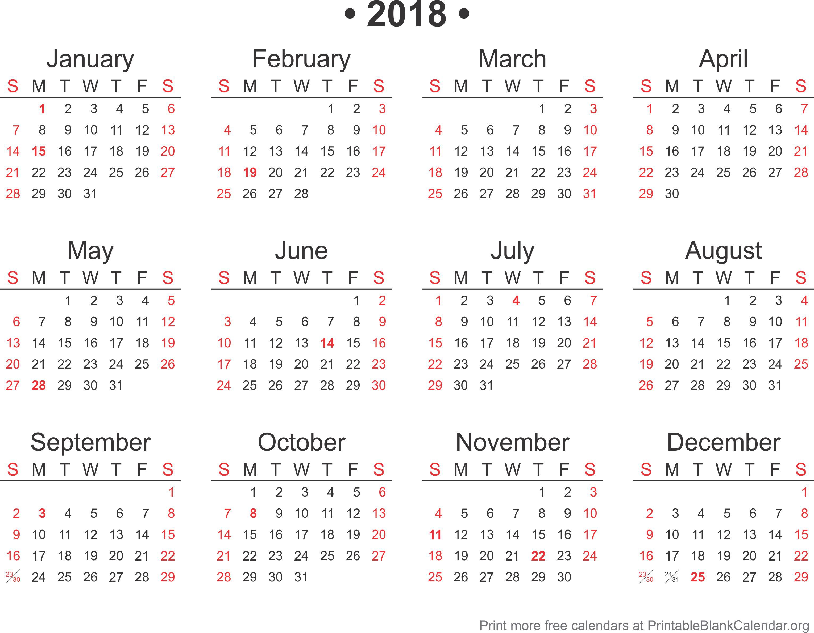
Time Line
You are here
17/18 Reports Due
Notes:
Assessment reports are due annually on June 30th. If that date doesn’t work for your program, contact OPA.

Slide 28

Assessing Our Own Process
Meta-Assessment
Office of Planning and Assessment
Notes:
We have begun assessing our own process through conversations with campus leadership. We’ll be developing a survey to gather your experiences in the future.

Slide 29
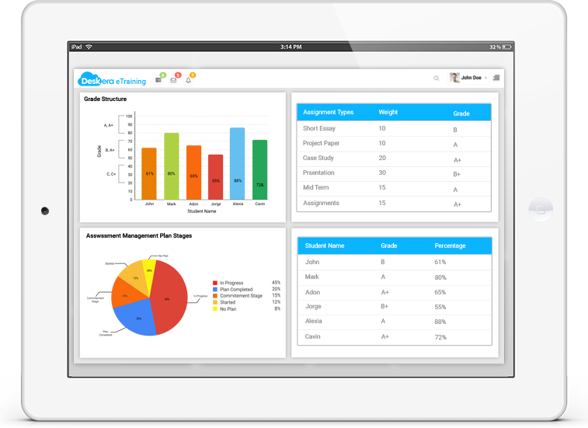
Assessment Management System
Fall 2018 (Pilot)
Office of Planning and Assessment
Notes:
A request for proposals from AMS vendors will be going out any day now. We expect to have a system in place by mid-summer and begin piloting it during 2018/2019.

Slide 30
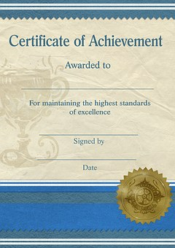
Certificates and Associate Programs
Associate’s Degree
Office of Planning and Assessment
Notes:
The assessment process included certificates and associate’s programs, but we didn’t pay a lot of attention to them last year. If you are involved in any of these programs you’ll be hearing from us.

Slide 31

Disciplinary Communities
Office of Planning and Assessment
Notes:
We continue to work with communities of faculty members who teach in the same program at different locations. Our role is to help them align program learning objectives and share assessment information with each other. If you are part of one of these groups and would like to meet, please let us know.

Slide 32

Online training (in development)
Office of Planning and Assessment
Notes:
Based on feedback we are developing additional resources. We are also developing some online trainings for those who prefer learning in this way.

Slide 33
Questions
Questions?
Contact your LOA liaison
College / Campus Liaisons
Office of Planning and Assessment
Notes:
Each college/campus has an LOA liaison in our office. You can find out who your liaison is by following the link below.
http://www.opa.psu.edu/learning-outcomes-assessment/collegecampus-liaisons/

